Slide 1
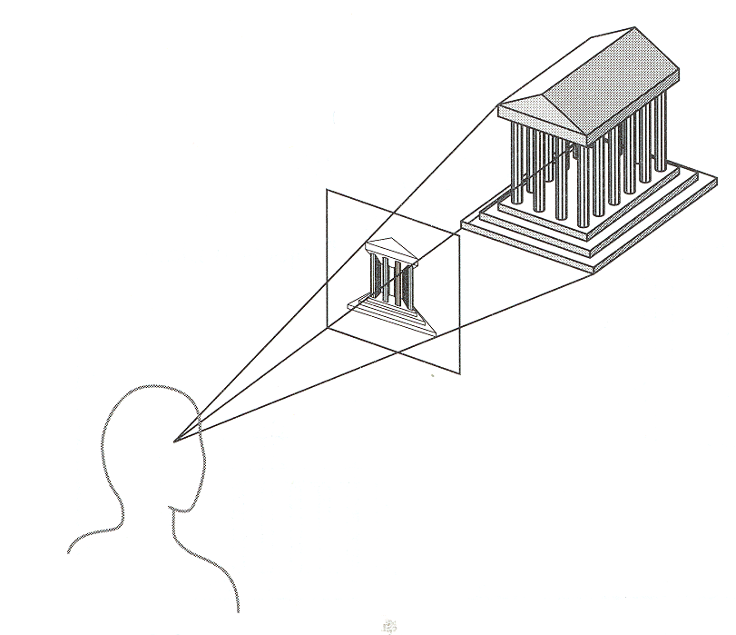
Projections
Angel: Interactive Computer Graphics

Slide 2
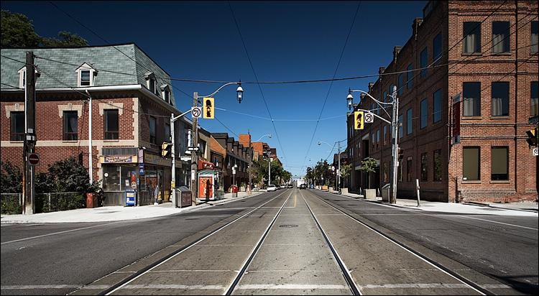
Road in perspective

Slide 3
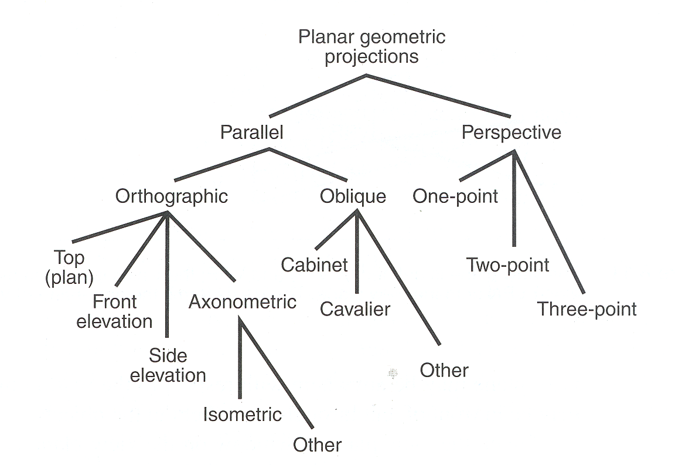
Taxonomy of Projections
FVFHP Figure 6.10

Slide 4
Taxonomy of Projections

Slide 5
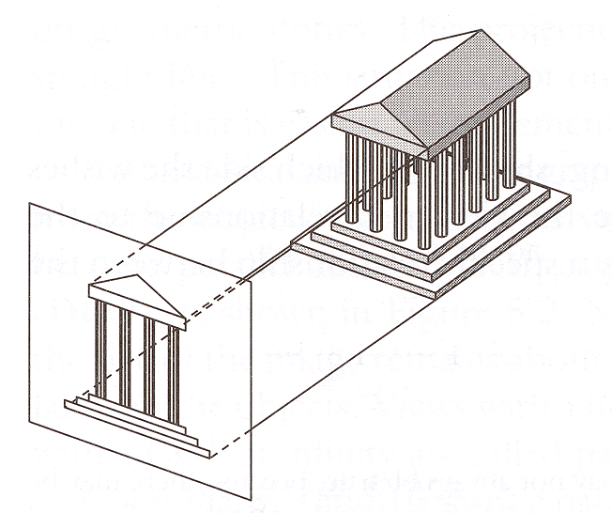
Parallel Projection
Center of projection is at infinity
Direction of projection (DOP) same for all points
View
Plane
DOP
Angel Figure 5.4

Slide 6
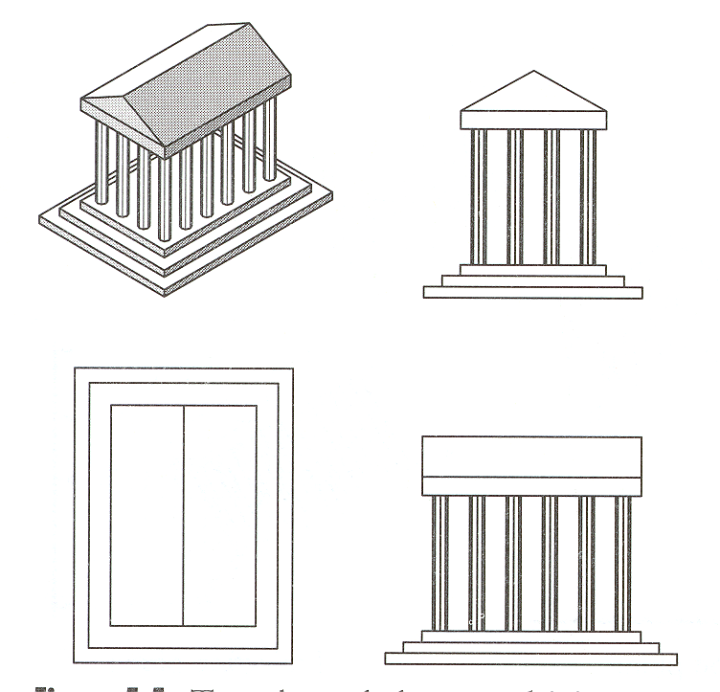
Orthographic Projections
DOP perpendicular to view plane
Front
Angel Figure 5.5
Top
Side

Slide 7
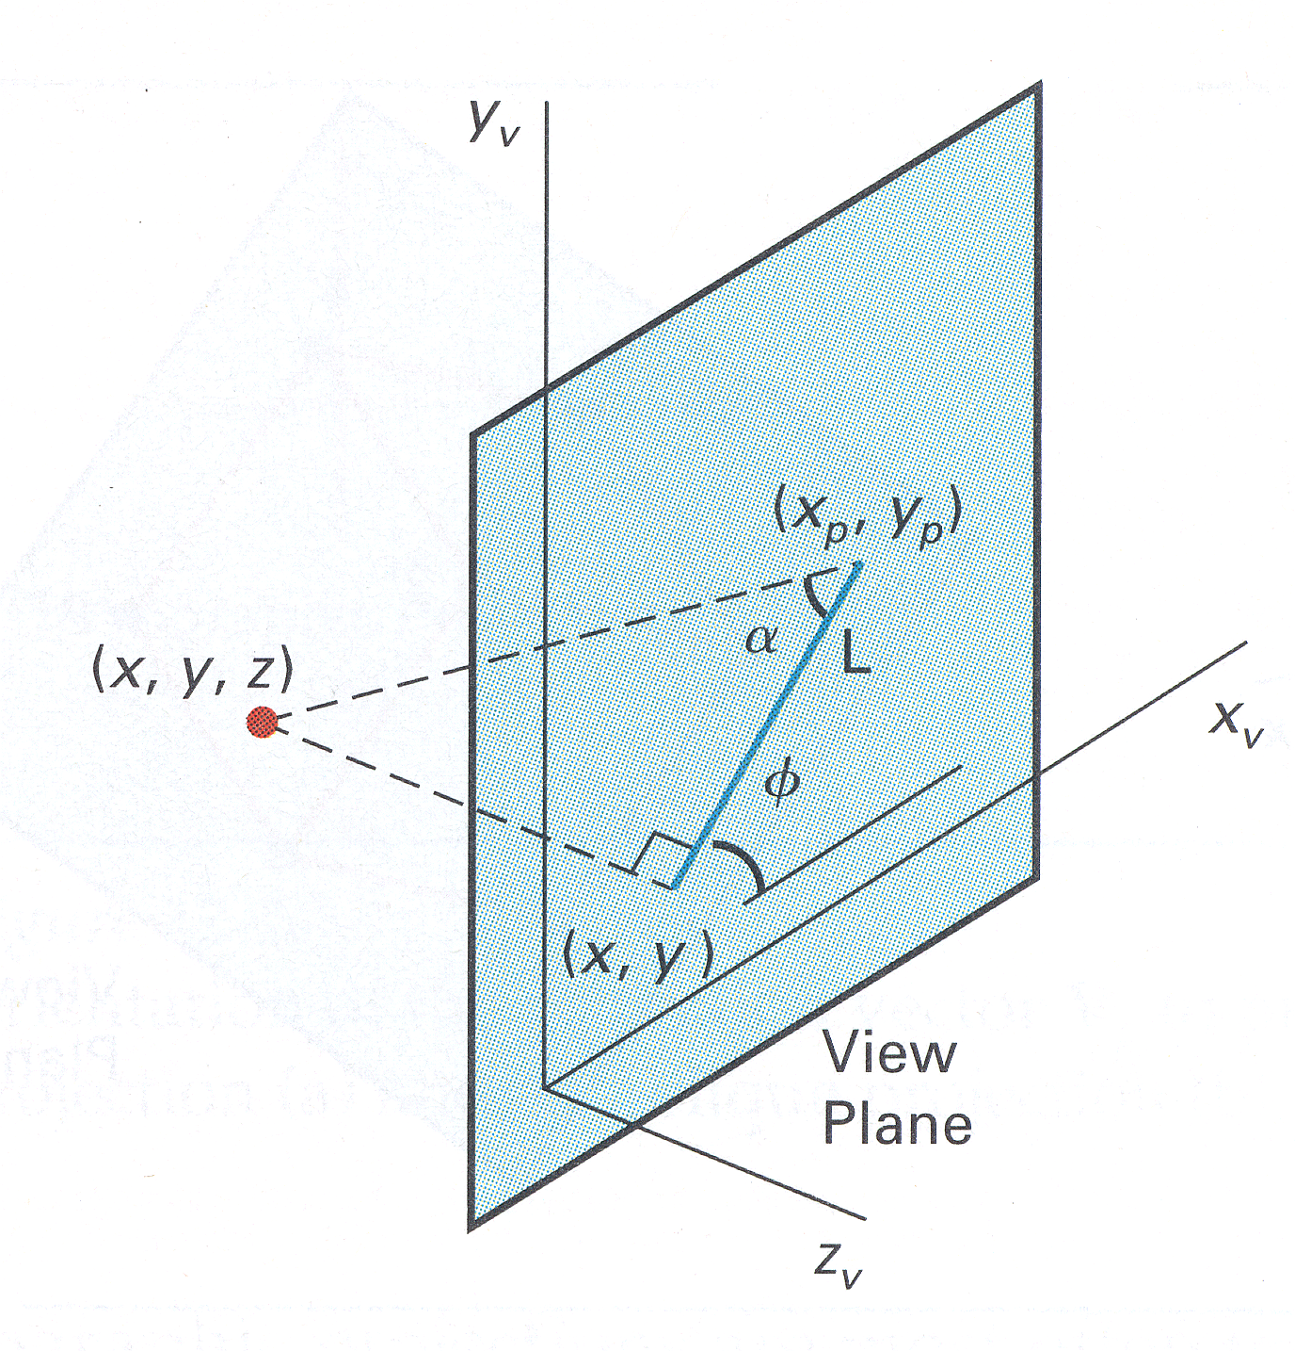
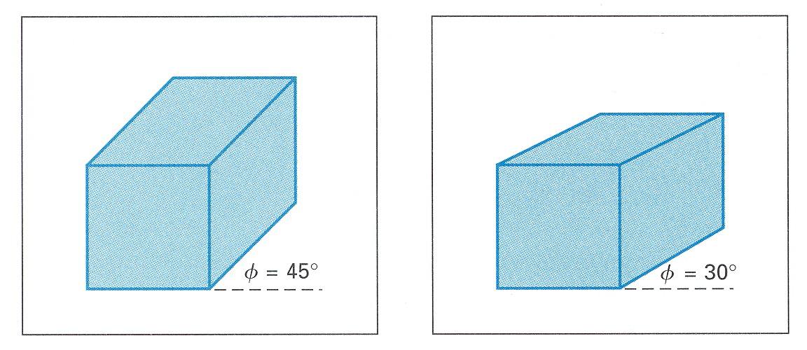
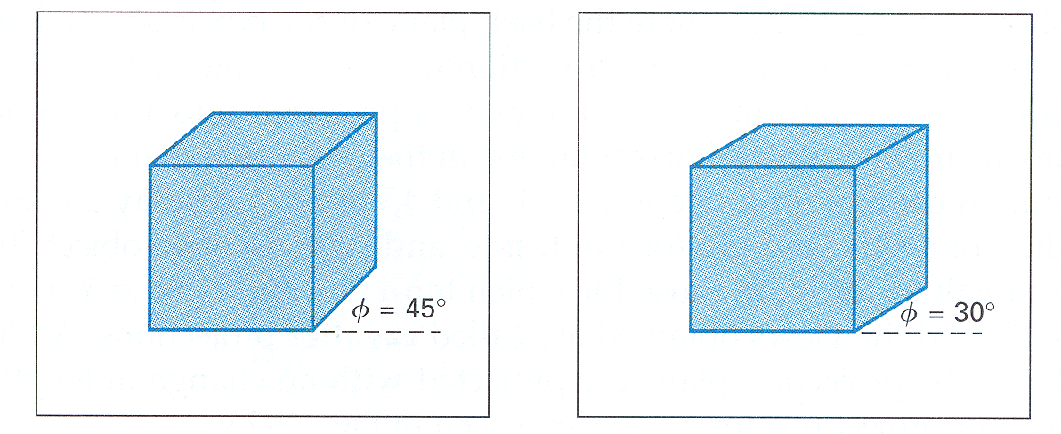
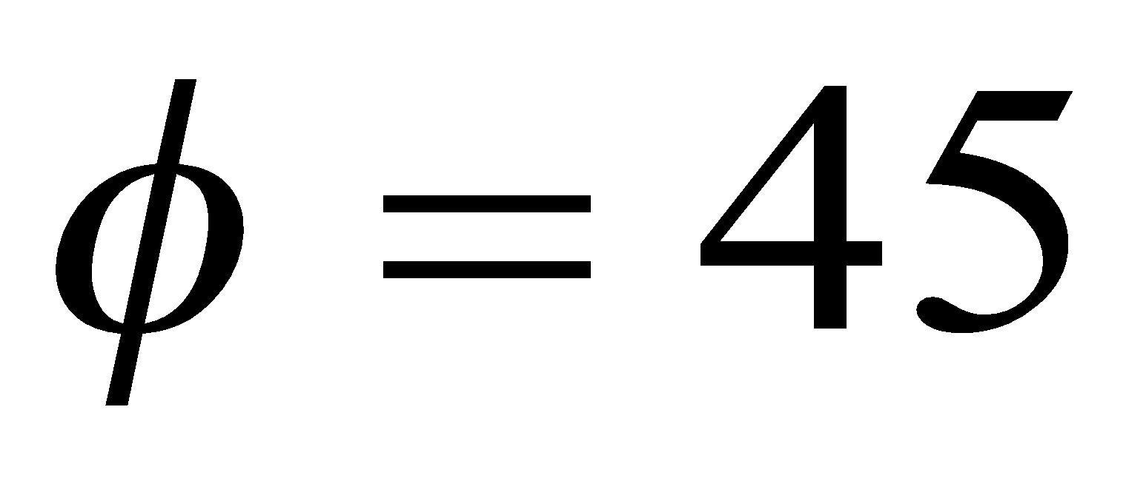
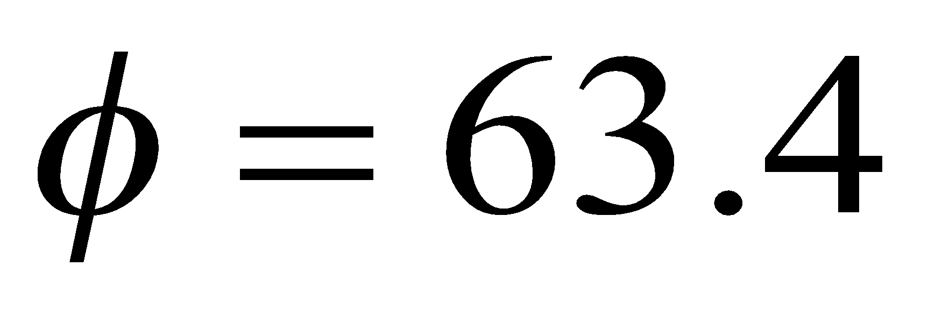
Oblique Projections
DOP not perpendicular to view plane
Cavalier
(DOP α = 45º)
tan(α) = 1
Cabinet
(DOP α = 63.4º)
tan(α) = 2
H&B

Slide 8
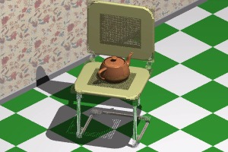
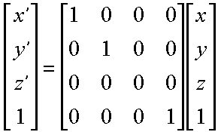
Orthographic Projection
Simple Orthographic Transformation
Original world units are preserved
Pixel units are preferred

Slide 9
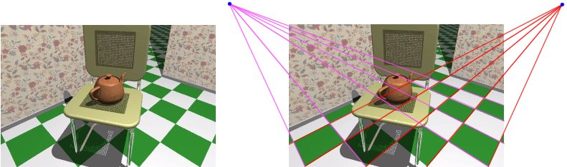
Perspective Transformation
First discovered by Donatello, Brunelleschi, and DaVinci during Renaissance
Objects closer to viewer look larger
Parallel lines appear to converge to single point

Slide 10
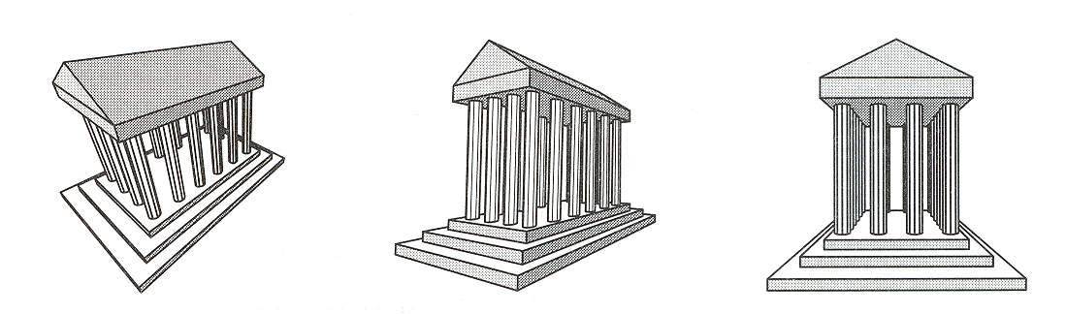
Perspective Projection
How many vanishing points?
3-Point
Perspective
2-Point
Perspective
1-Point
Perspective
Angel Figure 5.10

Slide 11
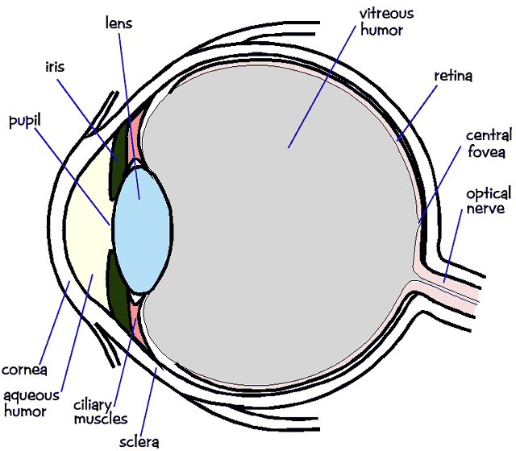
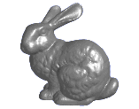
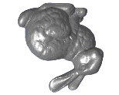
Perspective Projection
In the real world, objects exhibit perspective foreshortening: distant objects appear smaller
The basic situation:

Slide 12
Perspective Projection
When we do 3-D graphics, we think of the screen as a 2-D window onto the 3-D world:
How tall should this bunny be?

Slide 13
Perspective Projection
The geometry of the situation is that of similar triangles. View from above:
What is x’ ?
X
View plane
P (x, y, z)
(0,0,0)
x’ = ?
Z
d

Slide 14
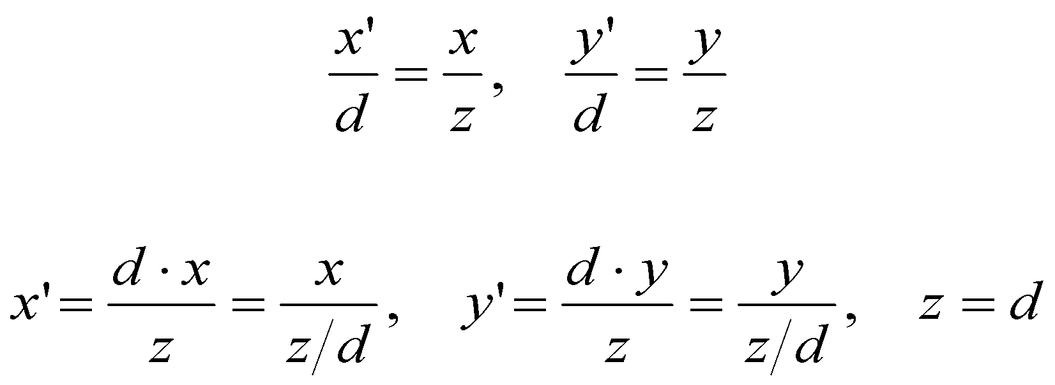
Perspective Projection
Desired result for a point [x, y, z, 1]^{T} projected onto the view plane:
What could a matrix look like to do this?

Slide 15
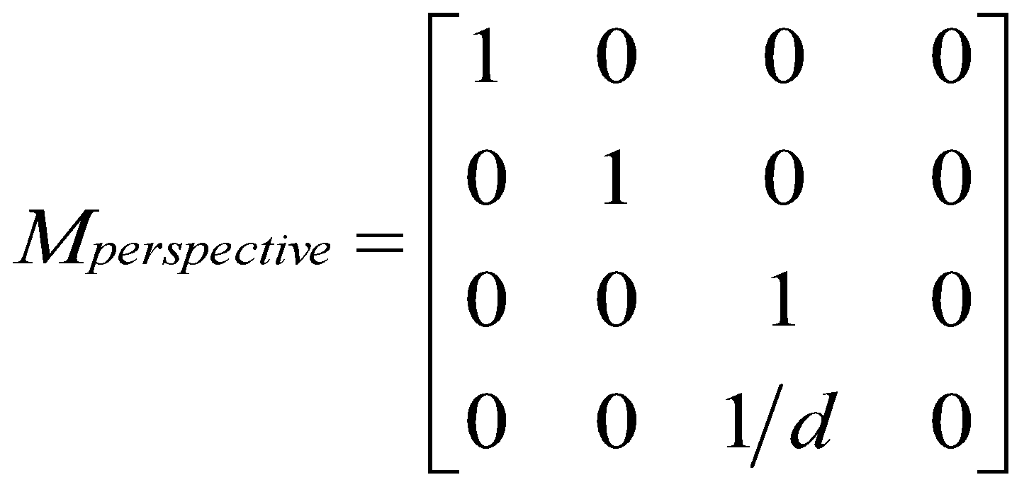
A Perspective Projection Matrix
Answer:

Slide 16
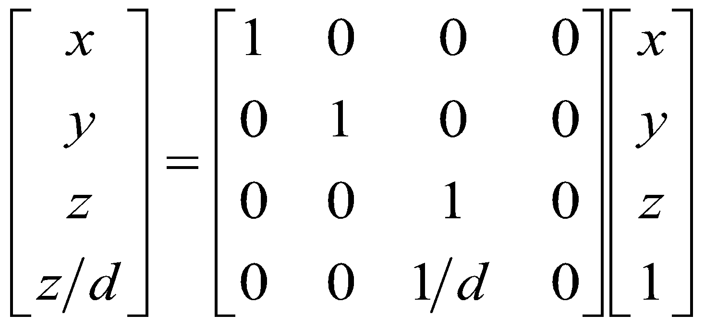
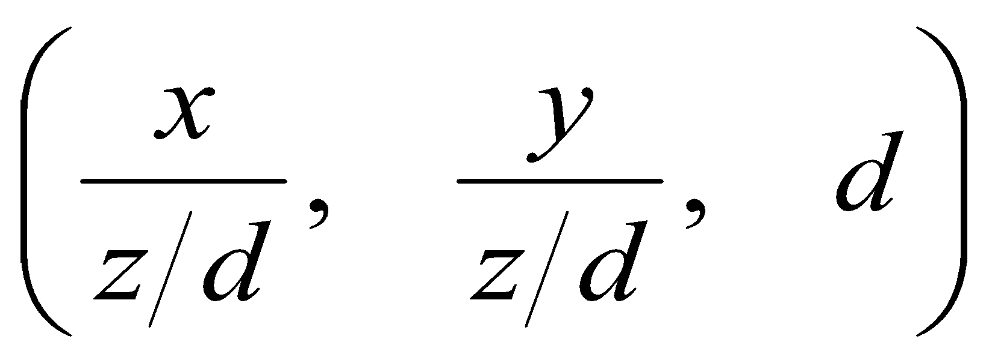
A Perspective Projection Matrix
Example:
Or, in 3-D coordinates:

Slide 17
Projection Matrices
Now that we can express perspective foreshortening as a matrix, we can compose it onto our other matrices with the usual matrix multiplication
End result: a single matrix encapsulating modeling, viewing, and projection transforms

Slide 18
Perspective vs. Parallel
Perspective projection
Size varies inversely with distance - looks realistic
Distance and angles are not (in general) preserved
Parallel lines do not (in general) remain parallel
Parallel projection
Good for exact measurements
Parallel lines remain parallel
Angles are not (in general) preserved
Less realistic looking

Slide 19
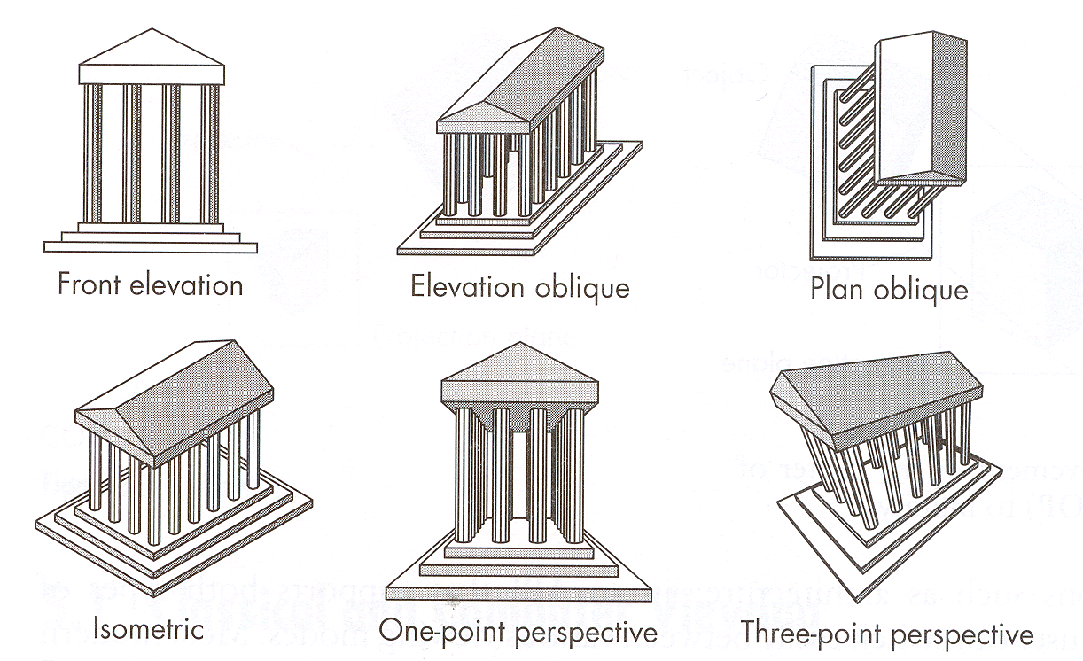
Classical Projections
Angel Figure 5.3

Slide 20
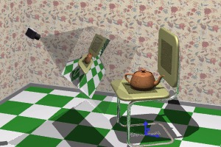
A 3D Scene
Notice the presence of the camera, the projection plane, and the world coordinate axes
Viewing transformations define how to acquire the image on the projection plane

Slide 21
Q1
Using the origin as the centre of projection, derive the perspective transformation onto the plane passing through the point R₀(x₀,y₀,z₀) and having normal vector N=n₁i+n₂j+n₃k

Slide 22
A1
P(x,y,z) is projected onto P’(x’,y’,z’)
x’=αx, y’= αy , z’= αz
n₁x’+n₂y’+n₃z’=d (where d=n₁x₀+n₂y₀+n₃z₀)
α=d/(n₁x+n₂y+n₃z)
d 0 0 0
Per_{N,R0}= 0 d 0 0
0 0 d 0
n₁ n₂ n₃ 0

Slide 23
Q2
Find the perspective projection onto the view plane z=d where the centre of projection is the origin(0,0,0)

Slide 24
Q3
Derive the general perspective transformation onto a plane with reference point R₀(x₀,y₀,z₀), normal vector N=n₁i+n₂j+n₃k, and using C(a,b,c) as the centre of projection

Slide 25
A3
Per_{N,R0’}=T_{C}. Per_{N,R0} .T_{-C}

Slide 26
Q4
Derive parallel projection onto xy plane in the direction of projection V=ai+bj+ck

Slide 27
A4
x’-x=ka , y’-y=kb , z’-z=kc
K=-z/c (z=0 on xy plane)
1 0 -a/c
Par_{V}= 0 1 -b/c
0 0 0

